Slide 1
Digital Ventures – FitCar

Slide 2

What is Fitcar™?
Our research has shown that our customers are often too busy to track their vehicle’s maintenance & they’re concerned about unexpected costs & surprises.
Fitcar™ is building a landscape of mobility services utilizing connected devices and big data to harvest real time, location based vehicle & driver information. These are turned into contextual, cross-business offers for existing Shell products & new adjacent business models.
READY. SET. CONNECT.
EASY VEHICLE CARE.

Slide 3
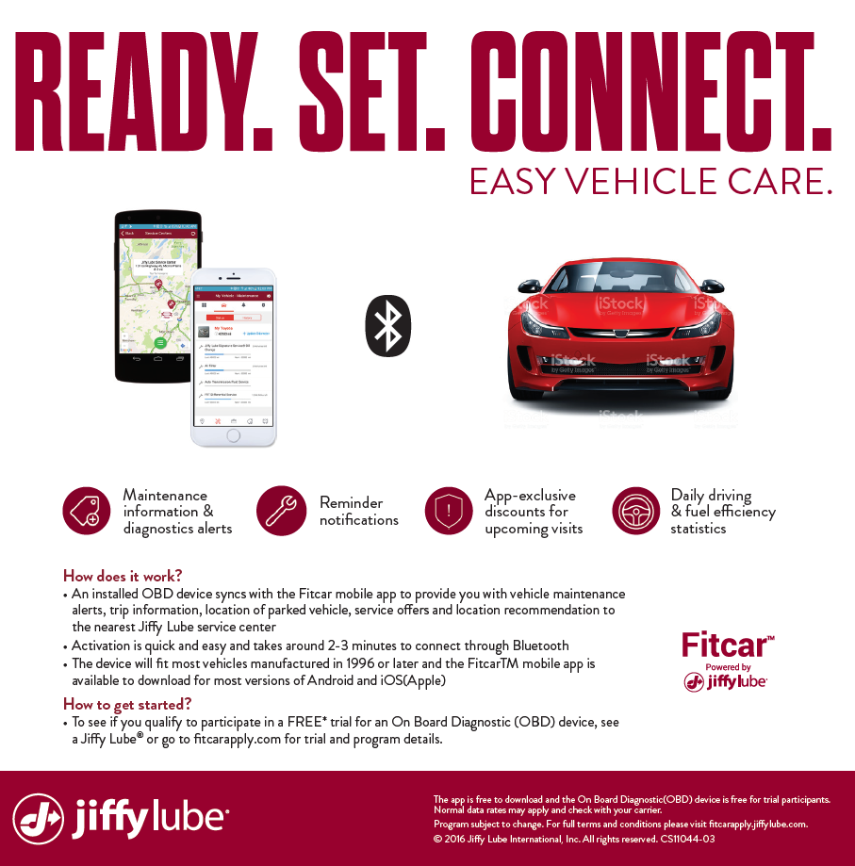
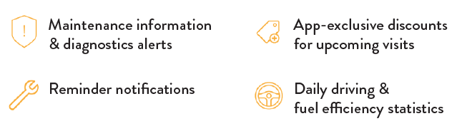
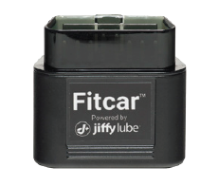
How does Fitcar™ work? The OBD device is plugged into the customers’ vehicle to collects and transmits data about the vehicle's current state onto the mobile app via Bluetooth.
MOBILE APP
ONBOARD DIAGNOSTIC DEVICE
Key CVPs
Maintenance information & diagnostic alerts
Emissions testing
App-exclusive discounts, user based insurance
Daily driving & fuel efficiency statistics
Fleet management

Slide 4
FitCar - BOLA
Opportunity Description | FitCar is a digital venture being incubated under Integrated Energy Solutions which provides a platform for Shell to connect to OBD devices plugged into customers’ vehicle to collects and transmits data about the vehicle's current state onto the mobile app via Bluetooth. Number of users targeted for YE 2017 is 1m users in US. Use cases across OEMs, Insurances, Data Monetization can be unlocked by applying Machine Learning techniques on the collected data and generating insights based on vehicle and driver performance/behaviour/maintenance.
Detail | LOB: Integrated Energy Solutions Business Sponsor: Georg Burchardi Opportunity Lead: Diego Ferrari DS Business Priorities: Sales Volume & Market Growth DS LOB Business Innovation Themes: DS - Sales Volume & Market Growth Technology Innovation Themes: Advanced Analytics Requestor / Author: Diego Ferrari
Deliverables | Phase 1 – Discovery: - Data permissions - Data Connection/Recovery – acquiring relevant data - Data Discovery - Solution Design | Phase 2 Solution: - Data Model Build - Simulation Build - Back-testing and evaluation of indicator scores - Visualization development
Risks | Data availability Predictive power of chosen data sources SME engagement / time allocation
Benefits | Pathfinder exercise for application of innovative Machine Learning approaches to Shell Digital Ventures and new business models for Shell and for de-risking future investments Opportunity with expected NPV Improved understanding of fuel performance and maintenance requirements per OEM – could lead to additional use cases in Lubricants Analytics can un-lock new revenue streams for the venture

Slide 5
Advanced Analytics use cases for Fitcar
Generate recommendation on driving style to end-users using predictions on fuel consumption and lubricants replenishment. (example: by reducing maximum speed by 5kh/m on average you will save 100$/year)
Benefit will include increased user attraction and retention
This use case will help FitCar incrase the number of qualified drivers for insurance offers
NPV allocation for this use case: 20% of FitCar Business Plan “Insurance (Policy Leads & Claims support)”
Proactive preventive maintenance (even before OEM recommendation) to increases frequency of visit to Shell branded workshop and more customized recommendation to end-users based on their driving patterns
Data to be used: mileage, speed, accelerometer, type of roads, prediction on whether a big trip is coming up, breaks usage, oil changes, engine information, fuel consumption, frequency of re-fuelling, geo-location, accidents/breakages (if preset in car logs).
This customized analysis could also be sold to insurances and / or cross-sell/up-sell of Shell products
NPV allocation for this use case: 30% of FitCar Business Plan “Tires, breaks, battery services”
Monetize spatial data aggregated info for retailers (Fuel or other road retailers) or government (for infrastructure maintenance) to better understand example behaviours from their customers, eg. demographics, type of car, know when they stop at stations and competitors
This could also be monetized through internal Shell Retail use cases
NPV allocation: 100% of FitCar Business Plan "Data (aggregated) sales to OEMs, tier-1 and government agencies"
Use case | NPV 2017 (USD mln) | NPV 2018 (USD mln) | NPV 2019 (USD mln) | NPV 2020 (USD mln) | NPV 2021 (USD mln) | 5-y NPV (USD mln)
Customized user recommendations | 0.0 | 5.4 | 10.5 | 13.7 | 17.0 | 46.6
Proactive preventive maintenance | 0.0 | 0.5 | 1.1 | 1.6 | 1.8 | 5.0
Monetize data packages | 0.0 | 0.0 | 0.0 | 0.0 | 1.0 | 1.0
TOTAL |  |  |  |  |  | 52.6

Slide 6
FitCar AA use cases Roadmap
Today
Jul 2017
Oct 2017
Dec 2017
Customized user
recommendations
2 weeks
2 weeks
4 weeks
4 weeks
6 weeks
Business review
8 weeks
Business review
Sign off project charter
(Tbc)
Data Collection
(Tbc)
Data Extraction & Exploration
(Tbc)
Refine use case
(Tbc)
Modelling
(Tbc)
Real-time integration with FitCar platform
(Tbc)
Proactive
preventive
maintenance
2 weeks
2 weeks
4 weeks
4 weeks
6 weeks
Business review
8 weeks
Business review
Sign off project charter
(Tbc)
Data Collection
(Tbc)
Data Extraction & Exploration
(Tbc)
Refine use case
(Tbc)
Modelling
(Tbc)
Real-time integration with FitCar platform
(Tbc)
During Data Exploration, we will perform a detailed feasibility assessment for the use cases. For preventive maintenance, we expect we will need historical data to be able to predict optimal time for maintenance. For Drivers' recommendations we expect less data to be required.

Slide 7
FitCar AA PoC – cost-breakdown
Resource | Role | Cost ($k)
Diego Ferrari | Opportunity Lead | 10
Paul Spurgeon | Project Manager | 30
Winfried Theis (supervising), Vasileios Giagkoulas | Data Science team | 60
Krishna Somasundaram | Architect | 4
Environment | Machine Learning environment for development and back-testing of models | 6
Data | We assume no requirement for acquisition of external data-sets | 0
Visualization | Developer (assumption that integration of insights with end-user front-end will be covered by venture development team) | 0
Contingency | - | 10
Total | - | 120
Considerations
D1 budget provided by AA CoE
Go / No-Go decision for development of any scoped opportunity will not be within the scope of the study
Business effort to be absorbed by departmental overhead

